Slide 1
Species Habitat Modeling using randomForest in the R environment for statistical analysis
FNAI
Emilie Henderson
(with thanks to Tim Howard)
October 5, 2014

Slide 2
Introduction
Notes:
As I mentioned in the notes in the prev slide. Perhaps a few minutes on workflow.

Slide 3
What are Element Distribution Models?
A prediction of the most suitable habitats for a species or natural community
Based on known locations for that species AND known environmental conditions.
Spatial Data:
LANDSAT (Bands and transformations)
Climate
Soil parent material
Elevation (derivatives)
location
Statistical
Model
Species Data:
Element Occurrence Records (for rare types)
Predictive Map
of
Species Habitats
Notes:
Probably already covered, but worth repeating

Slide 4

Why R?
.tif file of predictions
Random Forest Package
RODBC package (data input/output)
Raster package
Dismo package
Modeling Data
EO Shapefile
Environmental Layers

Slide 5
Why R?
Things R can do:
Interact with databases
Pull information from gridded spatial data layers
Build random forest models
Characterize accuracy of random forest models
Build graphics to describe model accuracy
Build spatial grids of model predictions
Automate workflow
Save figures and build reports

Slide 6
Why doesn’t everyone use R?
A!!! ! !!!
A GH!!!

Slide 7
Goals for today:
Basic R navigation
manipulating vectors and data frames
Efficient data import and export to and from R
shapefile attribute tables, Access databases, .csv files
Translate Element occurrence polygons into a point sample for modeling
Build a randomForest model for presence-absence data
Assess model accuracy.
Build a map from that model.

Slide 8
What do you know about R?

Slide 9
Getting Started: R navigation, and data import
Notes:
This is good. We actually use RODBC to update other data tables of ours and to consistently grab or post information. If time, I could talk about this.

Slide 10
Objects in R
Some basic object types
Vector
Data types
Numeric
Character
Factor – efficiently store repetitive charactor vectors with numbers. Useful, but can produce bugs if handled improperly.
Data frame
Holds multiple vectors together, can be of different formats
List
Holds multiple objects of any type together.

Slide 11
Getting Data into R
Basic:
read.table
read.csv
read.dbf
(included in the ‘foreign’ library, and also the ‘shapefiles’ library – has slightly different formats for each)
More useful:
RODBC can pull data from
Access
Excel
SQL Server
... and others
Even More Useful:
sp package can pull information from
Shapefiles
raster package can pull information from
Many raster data formats

Slide 12
Within-R manipulations of data
Subsetting
based on indexes (i.e., how to pull out column 4)
Based on true-false vectors (i.e., how to pull out plots that have been screened as ‘OK’)
xtabs – Taking a long species table, and making it into a crosstab format
This is not something we’ll use for mapping from element occurrences, but it’s very useful for working with community-level data.
Notes:
Also commands like head(), tail(), str() could be mentioned here.

Slide 13
Packages in R
Extensions are abundant, and generally well-tested by the time they go public.
New and better stuff comes together all the time.
raster package constantly improving handling of raster maps in R.
dismo package is a shiny new package that came out this last year that is dedicated to species distribution modeling!
SDMTools is new (just out Aug 5).

Slide 14
R Studio time
1.0_BasicNavigation.R
1.1_DataInputAndOutput.R
1.2_FunctionsInR.R
(1.3_IntroToPlotting.R)

Slide 15
Data management
Notes:
You might be better off using the term ‘observations’ rather than plot? At any rate I can talk about using other input data, such as EO data or other observation data.

Slide 16
Spatial Data
Questions to ask before building spatial data for modeling
What spatial resolution and extent are needed?
What types of information are likely to be useful?
Types of spatial data that I use for modeling plants
Soil
Climate
Topography
Imagery
Things to pay attention to when building spatial data
Consistency
Grids MUST be of identical spatial extent, and snapped to the same upper-left coordinate
Projection
Projections must be identical among grids

Slide 17
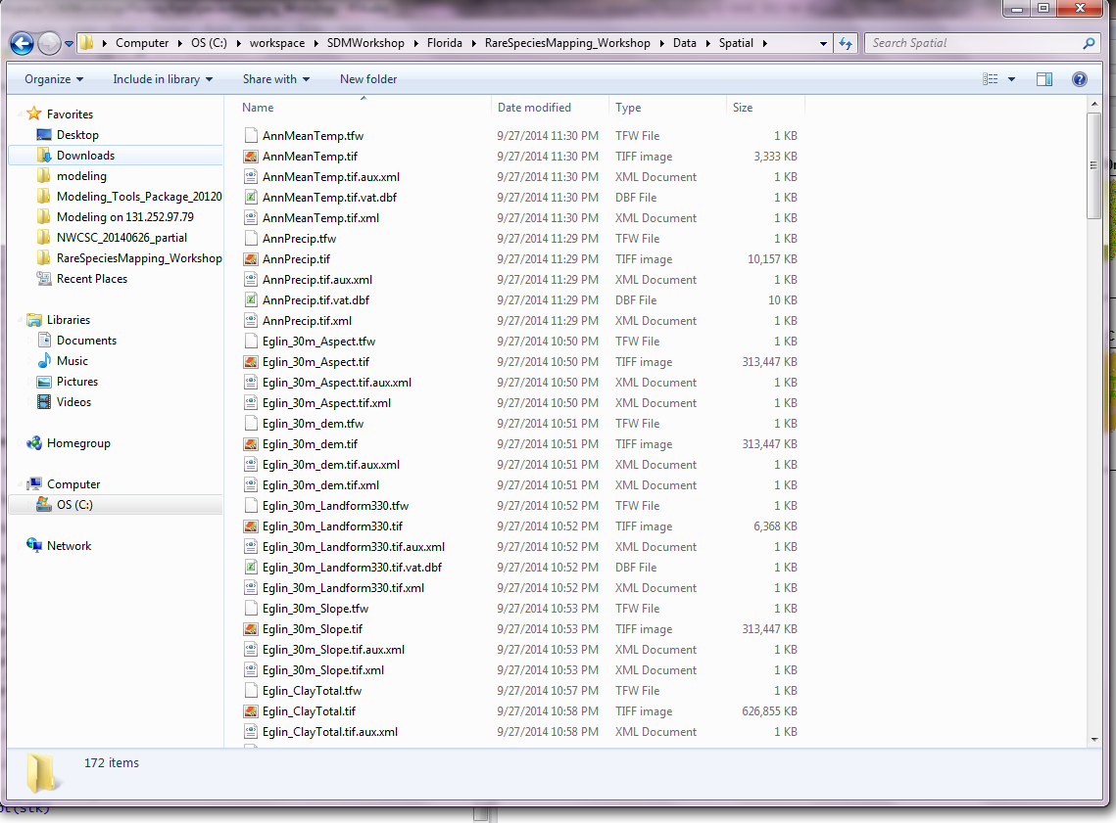
Spatial Data

Slide 18
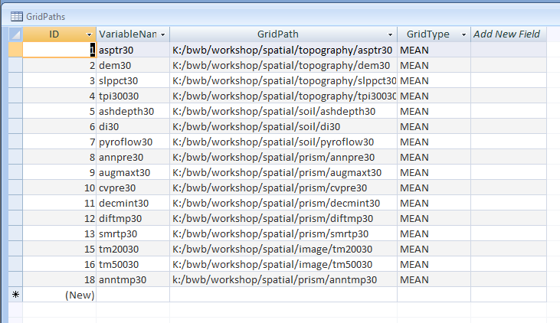
Organization of spatial data is key for efficient mapping workflow

Slide 19
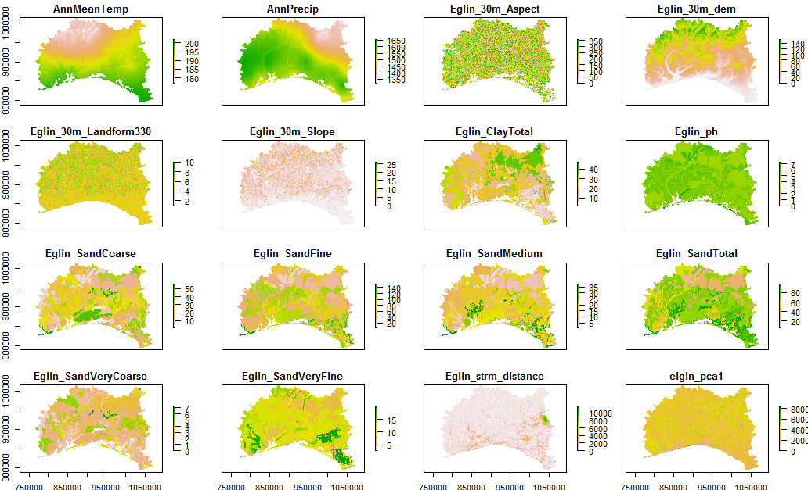

Slide 20
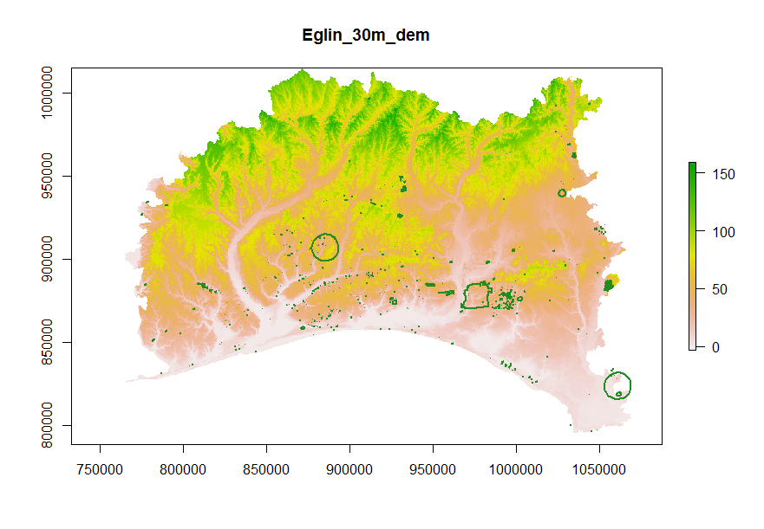
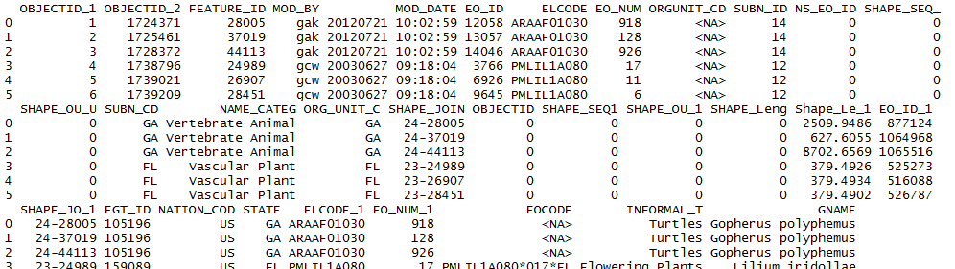
Species Data: Element Occurrence Records

Slide 21
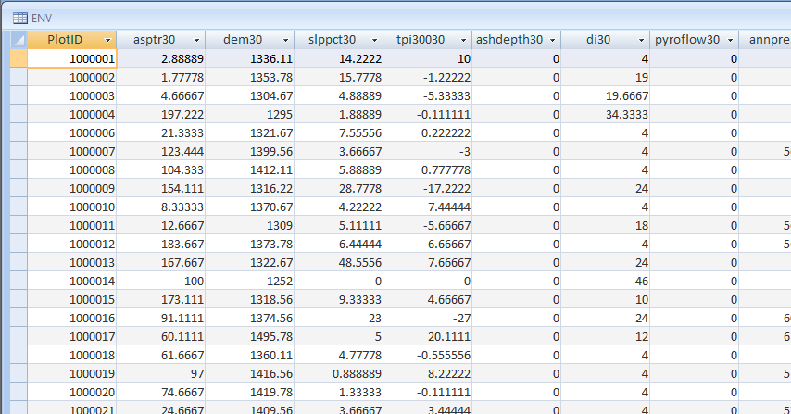
Plot-spatial data intersection
Sampling grain, modeling grain, and the intersection.
elevation
2
slope
1
aspect
3
temperature
precipitation
6
Landsat spectral reflectance – band 5
4
5

Slide 22
How to summarize large points that encompass many pixels?
I’ve used Matt Gregory’s ‘footprint.exe’ program for extracting averages of multi-pixel plot footprints. (freely available – ask me if you want a copy)

Slide 23

Question: Polygon to point?
New York
Natural Heritage Program
Equal # per poly
-bias for small
Equal # per area
-bias for large
Notes:
Presence needs to be represented as point data
Strove to get best of both worlds:
At small polygon size, larger polygons get more points
But this soon blows up, so at larger polygon size, limit to
A specific number per polygon.
Used logistic curve for this.
100 pts per polygon on the left
On a per area basis on the right.

Slide 24
Decision: logistic sampling
New York
Natural Heritage Program
Notes:
Y = # pts to put in polygon
A = asymptote height
k = shape of the curve (set to 0.004)
x = baseline points per area sample
Baseline is one point per pixel (but randomly placed)
But this maxes out quickly. Goal was to asymptote at a certain spot. Chose to asymptote at 80% max polygon size. Which is about 400 points.
Use logistic curve to do this.

Slide 25
Rstudio time
2_GetData.R

Slide 26
Model Building

Slide 27
Which Algorithm?
BIOCLIM
DOMAIN
MAXENT
GARP
Logistic Regression
Mahalanobis Distance
Classification and Regression Trees (CART)
Multivariate Adaptive Regression Splines (MARS)
Regression Tree Analysis
Bagging Trees
Random Forests **
Generalized Additive Models (GAM)
Neural Networks
See Elith et al. 2006, Prasad et al. 2006, Guisan and Zimmerman 2000

Slide 28
Random Forests
Compare presence points with background points to create classification trees (CART) based on environmental layers.
Randomly use a subset of the environmental layers and a subset of the points each time.
Build hundreds of trees, compare results among trees.
Breiman 2001
Prasad et al. 2006
Notes:
Does not overfit

Slide 29
# True / # Trees = 4/6 = .66

Slide 30
Interpretation of output
Random Forest may find many solutions
Final output reports the probability that the environmental conditions match the conditions where the target element is known to occur.
Both internal and external model validation, including confusion matrices, kappa and other metrics, ROC plots and AUC can be extracted.

Slide 31
Random Forest: What it can’t do.
Build a perfect map.
The methods we’re using here aren’t tuned for community-compositional analysis

Slide 32
Random Forest: What it can do well
Highlight locations that are worth visiting to look for species X
Highlight locations where re-introduction of Species X might be worthwhile

Slide 33
Why select variables?
Occam’s razor
Simplest model possible = ‘good science’.
Processing time
More variables mean a more complicated model, means a longer run-time.
However:
randomForest is relatively robust to colinearity, so this step isn’t as crucial as it is for other techniques.
Plus, simple plot-validation level accuracy measures that can be used to select variables don’t describe some dimensions of map quality.
Notes:
Algorithms in for reverse selection available in SDMap, (generally based on species Kappas) as with the rest of this package, use them at your own risk, I haven’t modified them for quite awhile now.

Slide 34
A few parameters to play with
mtry = # of variables to try when building each split in each tree
ntree = # of trees in the virtual forest

Slide 35
Rstudio Time
3_ModelBuilding.R

Slide 36
Model Assessment

Slide 37
Types of Assessment
Model prediction strength
Focused on predictions at points (either new points, or points used in modeling.)
Binary measures
Continuous predictions (AUC)
Area assessments for categorical maps
The Laugh Test – Never ever skip this step.

Slide 38
Types of errors
False positives
False negatives
 | Predicted TRUE | Predicted FALSE
Observed TRUE | TP | FN
Observed FALSE | FP | TN

Slide 39
Consequences of types of errors for rare species maps.
False positives: wasted time surveying for possible occurrences, lost credibility
False negatives: Missed occurrences, if map informs development plans, and indicates no need for survey, then individuals may be at risk.

Slide 40
Setting a threshold for a binary transformation
If the probability is greater than 0.5, does it mean that species X is probably present?
Sadly, the answer is … nope.
Probability values are model-specific for random forest.
0.5 does not mean the same thing from model to model
This threshold affects which types of errors dominate your map.
THIS STEP IS REALLY IMPORTANT!

Slide 41
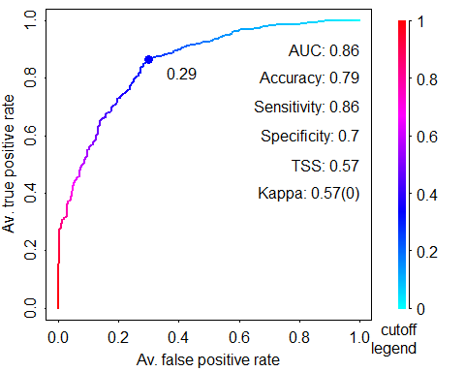
Choosing how to balance errors with ROC curves.

Slide 42
Rstudio Time
4.0_Accuracy_basic.R
(saving 4.1 for Tuesday)

Slide 43
Mapping

Slide 44
Rstudio Time
5.0_Mapping.R

